Slide 1
Mysql Database

Slide 2
SELECT Statements
The SQL SELECT Statement
The SELECT statement is used to select data from a database.
The data returned is stored in a result table, called the result-set.

Slide 3
For All records present in table
SELECT * FROM Customers;
For one column from the table
SELECT CustomerName FROM Customers;
For multiple column from the table
SELECT CustomerName ,City FROM Customers;

Slide 4
No Duplications
SELECT DISTINCT Country FROM Customers;
Count the duplications
SELECT COUNT(DISTINCT Country) FROM Customers;

Slide 5
SQL WHERE
The SQL WHERE Clause
The WHERE clause is used to filter records.
It is used to extract only those records that fulfill a specified condition.

Slide 6
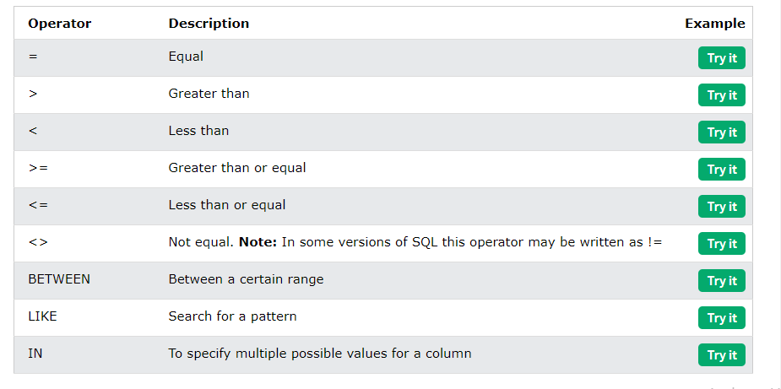

Slide 7
SELECT * FROM Customers WHERE Country='Mexico';
SELECT * FROM Products
WHERE Price > 30;
SELECT * FROM Products
WHERE Price < 30;
SELECT * FROM Products
WHERE Price >= 30;
SELECT * FROM Products
WHERE Price <= 30;
SELECT * FROM Products
WHERE Price <> 18;
SELECT * FROM Products
WHERE Price BETWEEN 50 AND 60;
SELECT * FROM Customers
WHERE City LIKE 's%';
SELECT * FROM Customers
WHERE City IN ('Paris','London');

Slide 8
The SQL AND, OR and NOT Operators
The SQL AND, OR and NOT Operators
The WHERE clause can be combined with AND, OR, and NOT operators.
The AND and OR operators are used to filter records based on more than one condition:
The AND operator displays a record if all the conditions separated by AND are TRUE.
The OR operator displays a record if any of the conditions separated by OR is TRUE.
The NOT operator displays a record if the condition(s) is NOT TRUE.

Slide 9
SELECT * FROM Customers
WHERE Country='Germany' AND City='Berlin';
SELECT * FROM Customers
WHERE City='Berlin' OR City='München';
SELECT * FROM Customers
WHERE NOT Country='Germany';

Slide 10
SELECT * FROM Customers
WHERE Country='Germany' AND (City='Berlin' OR City='München');
SELECT * FROM Customers WHERE NOT Country='Germany' AND NOT Country='USA';

Slide 11
The SQL ORDER BY
The SQL ORDER BY Keyword
The ORDER BY keyword is used to sort the result-set in ascending or descending order.
The ORDER BY keyword sorts the records in ascending order by default. To sort the records in descending order, use the DESC keyword.

Slide 12
Ascending Order
SELECT * FROM Customers
ORDER BY Country DESC;
Descending Order
SELECT * FROM Customers
ORDER BY Country DESC;
Multiple columns then separate with [,]
SELECT * FROM Customers ORDER BY Country, CustomerName;
SELECT * FROM Customers ORDER BY Country ASC, CustomerName DESC;

Slide 13
The SQL INSERT INTO Statement
The INSERT INTO statement is used to insert new records in a table.
INSERT INTO Syntax
It is possible to write the INSERT INTO statement in two ways:
1. Specify both the column names and the values to be inserted:
2. If you are adding values for all the columns of the table, you do not need to specify the column names in the SQL query. However, make sure the order of the values is in the same order as the columns in the table.

Slide 14
For whole table
INSERT INTO Customers (CustomerName, ContactName, Address, City, PostalCode, Country) VALUES ('Cardinal', 'Tom B. Erichsen', 'Skagen 21', 'Stavanger', '4006', 'Norway');
For only specified columns
INSERT INTO Customers (CustomerName, City, Country) VALUES ('Cardinal', 'Stavanger', 'Norway');

Slide 15
NULL Value
What is a NULL Value?
A field with a NULL value is a field with no value.
If a field in a table is optional, it is possible to insert a new record or update a record without adding a value to this field. Then, the field will be saved with a NULL value.
SELECT CustomerName, ContactName, Address FROM Customers WHERE Address IS NULL
SELECT CustomerName, ContactName, Address FROM Customers WHERE Address IS NOT NULL;

Slide 16
The SQL UPDATE Statement
The UPDATE statement is used to modify the existing records in a table.
UPDATE Syntax
UPDATE Customers SET ContactName = 'Alfred Schmidt', City= 'Frankfurt' WHERE CustomerID = 1;
Without Where clause it will update all records in customer
UPDATE Customers
SET ContactName='Juan';

Slide 17
The SQL DELETE
The SQL DELETE Statement The DELETE statement is used to delete existing records in a table. DELETE Syntax
DELETE FROM Customers WHERE CustomerName='Alfreds Futterkiste' ;

Slide 18
The SQL SELECT TOP
The SELECT TOP clause is used to specify the number of records to return.
The SELECT TOP clause is useful on large tables with thousands of records. Returning a large number of records can impact performance.

Slide 19
SELECT TOP 3 * FROM Customers;
SELECT * FROM Customers LIMIT 3;
SELECT * FROM Customers FETCH FIRST 3 ROWS ONLY;
SELECT TOP 50 PERCENT * FROM Customers;
SELECT * FROM Customers FETCH FIRST 50 PERCENT ROWS ONLY;
SELECT TOP 3 * FROM Customers WHERE Country='Germany';
SELECT * FROM Customers WHERE Country='Germany' LIMIT 3;

Slide 20
Sql Min and Max
The SQL MIN() and MAX() Functions
The MIN() function returns the smallest value of the selected column.
The MAX() function returns the largest value of the selected column.

Slide 21
SELECT MIN(Price) AS SmallestPrice FROM Products;
SELECT MAX(Price) AS LargestPrice FROM Products;

